Slide 1
Past tenses, animals, emotions
Matěj Trochta

Slide 2
My brother …… (make) a snow sculpture yesterday.
Dad …… (sleep) on a sofa, while mum …… (watch) TV.
We …… (be) ice-skating, when the ice …… (start) to crack.
I …… (hear) a loud cracking noise, when I …… (do) my homework.
We …… (have) a chicken and rice for lunch.
Jane and I …… (watch) a great film last Sunday at 5.

Slide 3
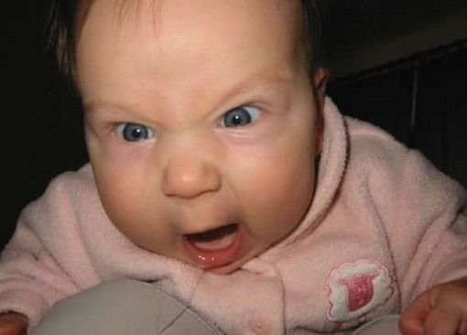
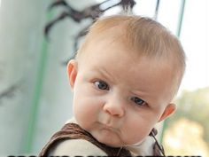
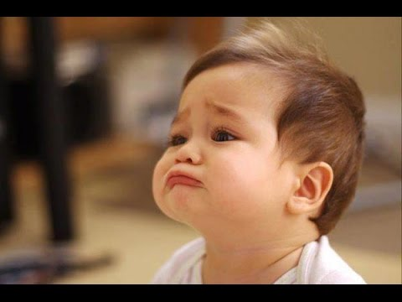
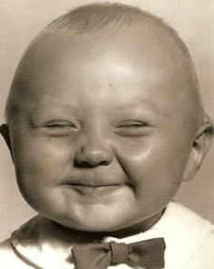
Translate the words and describe the pictures.
Frustrated
Scared
Angry
Nervous
Sad
Shocked
Happy
Excited
Peaceful
Relaxed

Slide 4
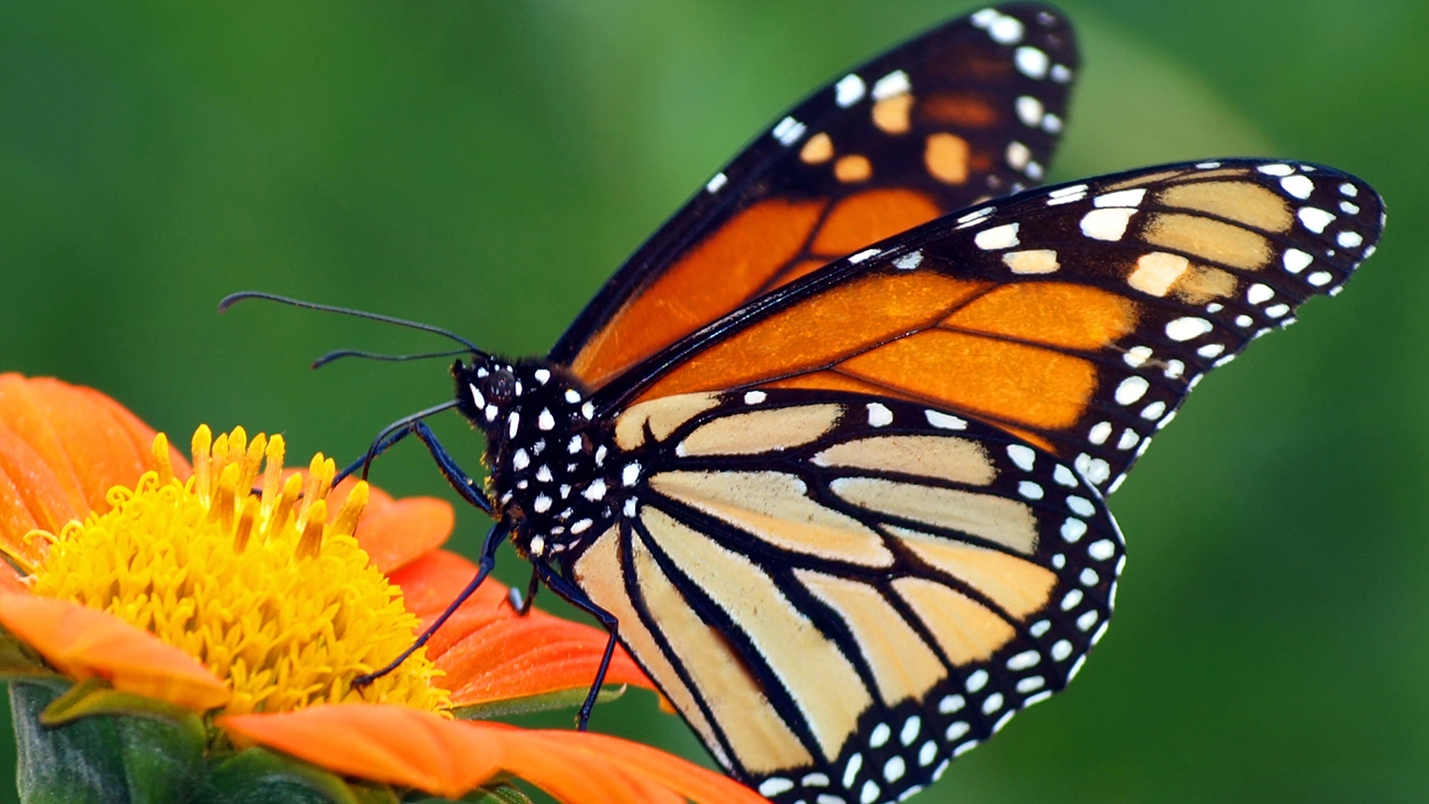
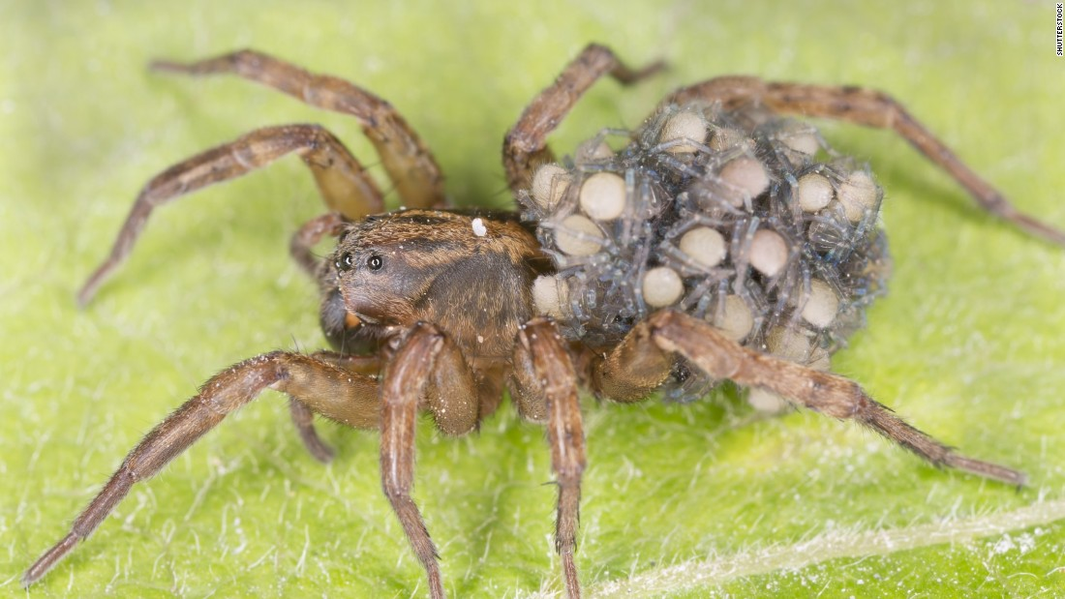
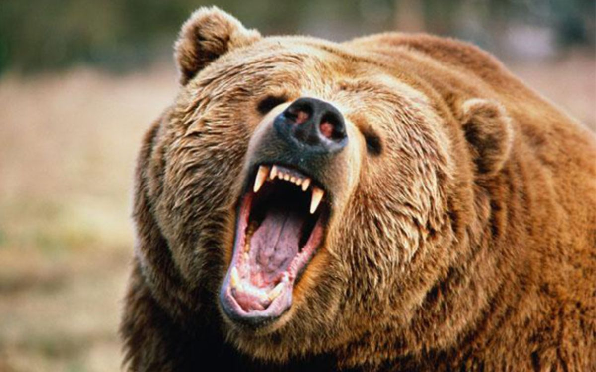
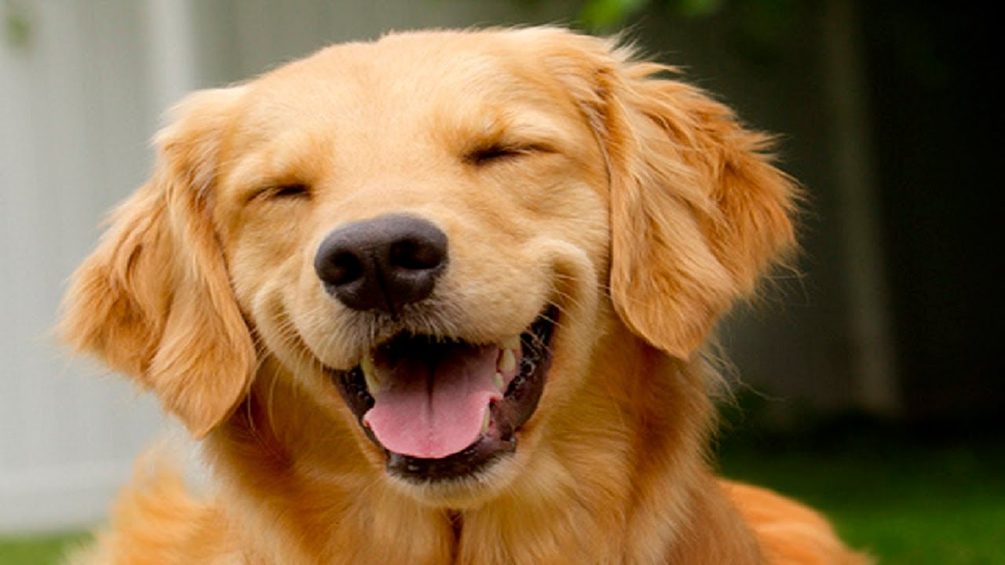
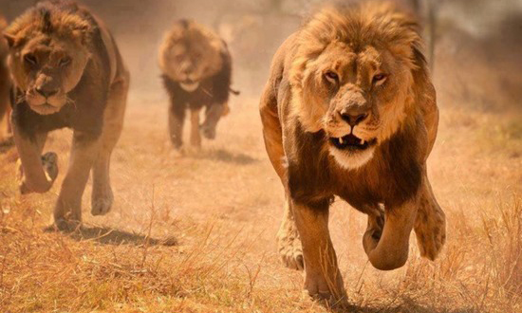
Describe body parts

Slide 5
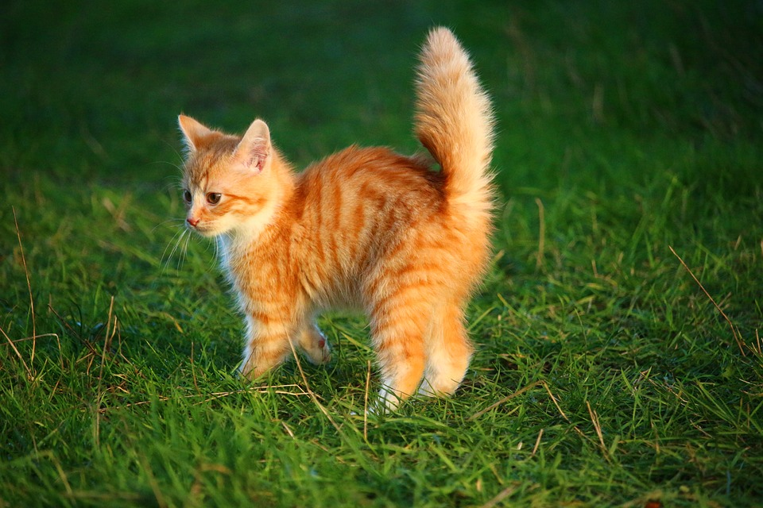

Slide 6
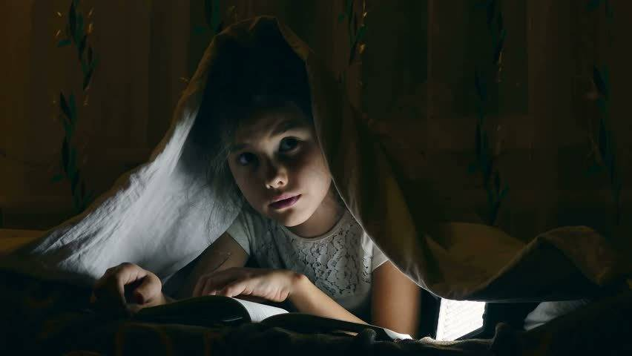
Are you scared ?
Listen.
What can you feel ?
There was a young girl, who was alone at home. She heard strange noise from the basement. She took her flashlight and walked into the basement, while she was coming closer, the noise became louder and louder. She saw some light, and when she opened the door, she saw…
Finish the story !

Slide 7
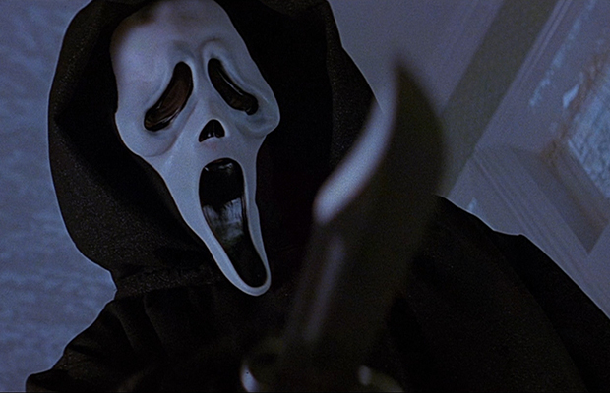
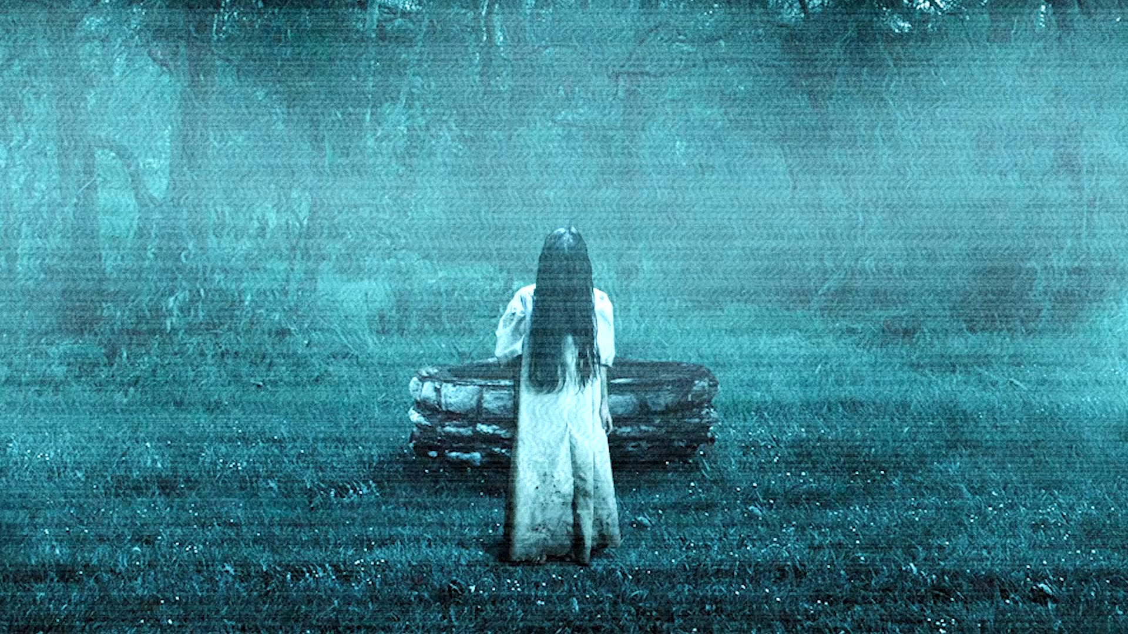
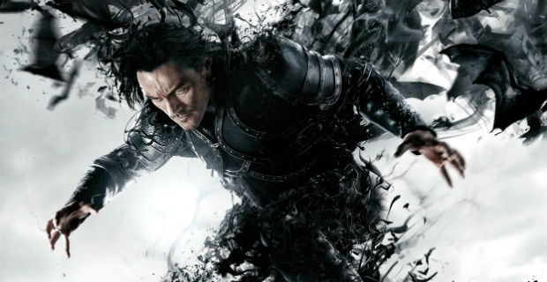
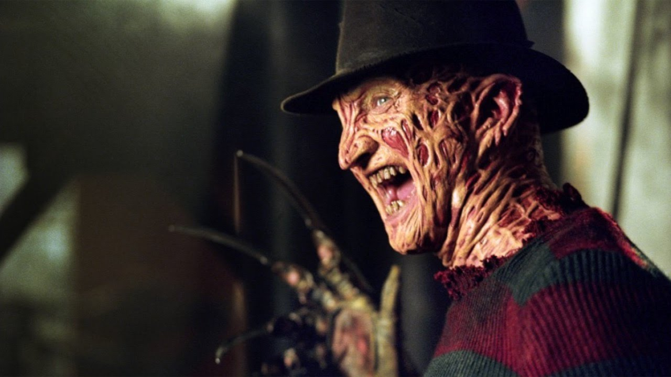
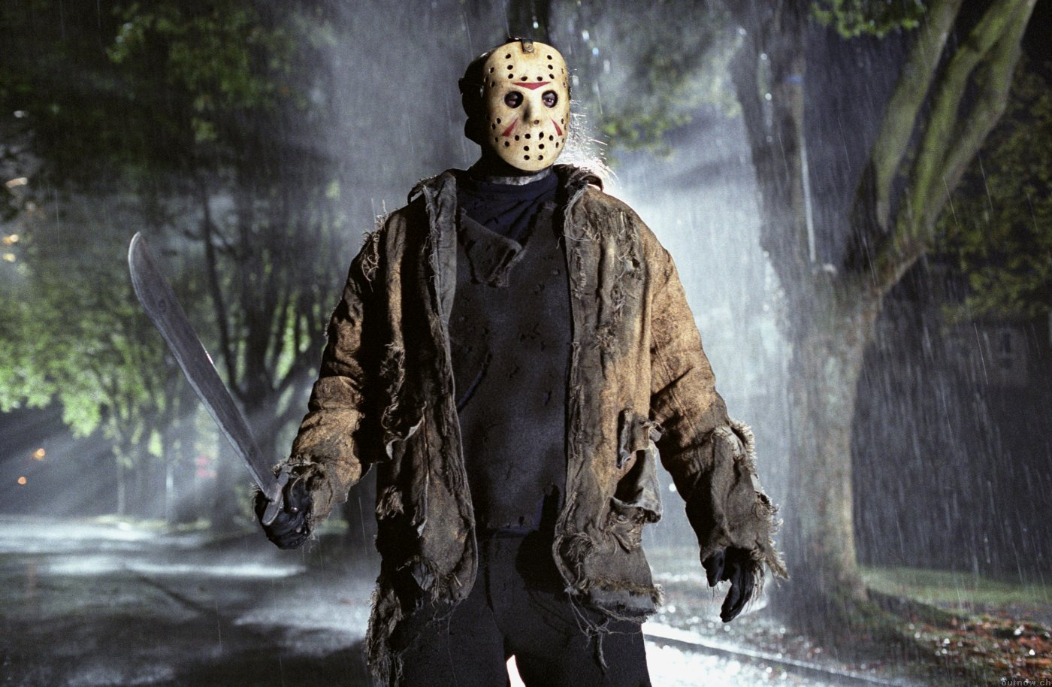
Do you like horrors ?
Do you know any of these monsters ?

Slide 8
Watch a short video and do the quiz !
Do you know, from what film the video is ?!
Who was the teacher speaking about ?
What colour was sweather of the girl ?
How many lockers were in the first half on the right side ?
What was the name of her friend ?
What was the clothing of her friend ?
How could happen next ?!

Slide 9
The end !
I hope you enjoyed ! ☺

